Slide 1


data@anz program
Virtual internship
Sothey sean

Slide 2
Data Exploratory Check the link below for more details: https://seansothey.github.io/anz-virtual-internship/anz_transactions_3months.html
Features | Missing % | Status
card_present_flag | 35.9 | Target/Label
Merchant_suburb | 35.9 | Trivia
merchant_state | 35.9 | Trivia
merchant_long_lat | 35.9 | Trivia
bpay_biller_code | 92.7 | To be removed
merchant_code | 92.7 | To be removed

Slide 3
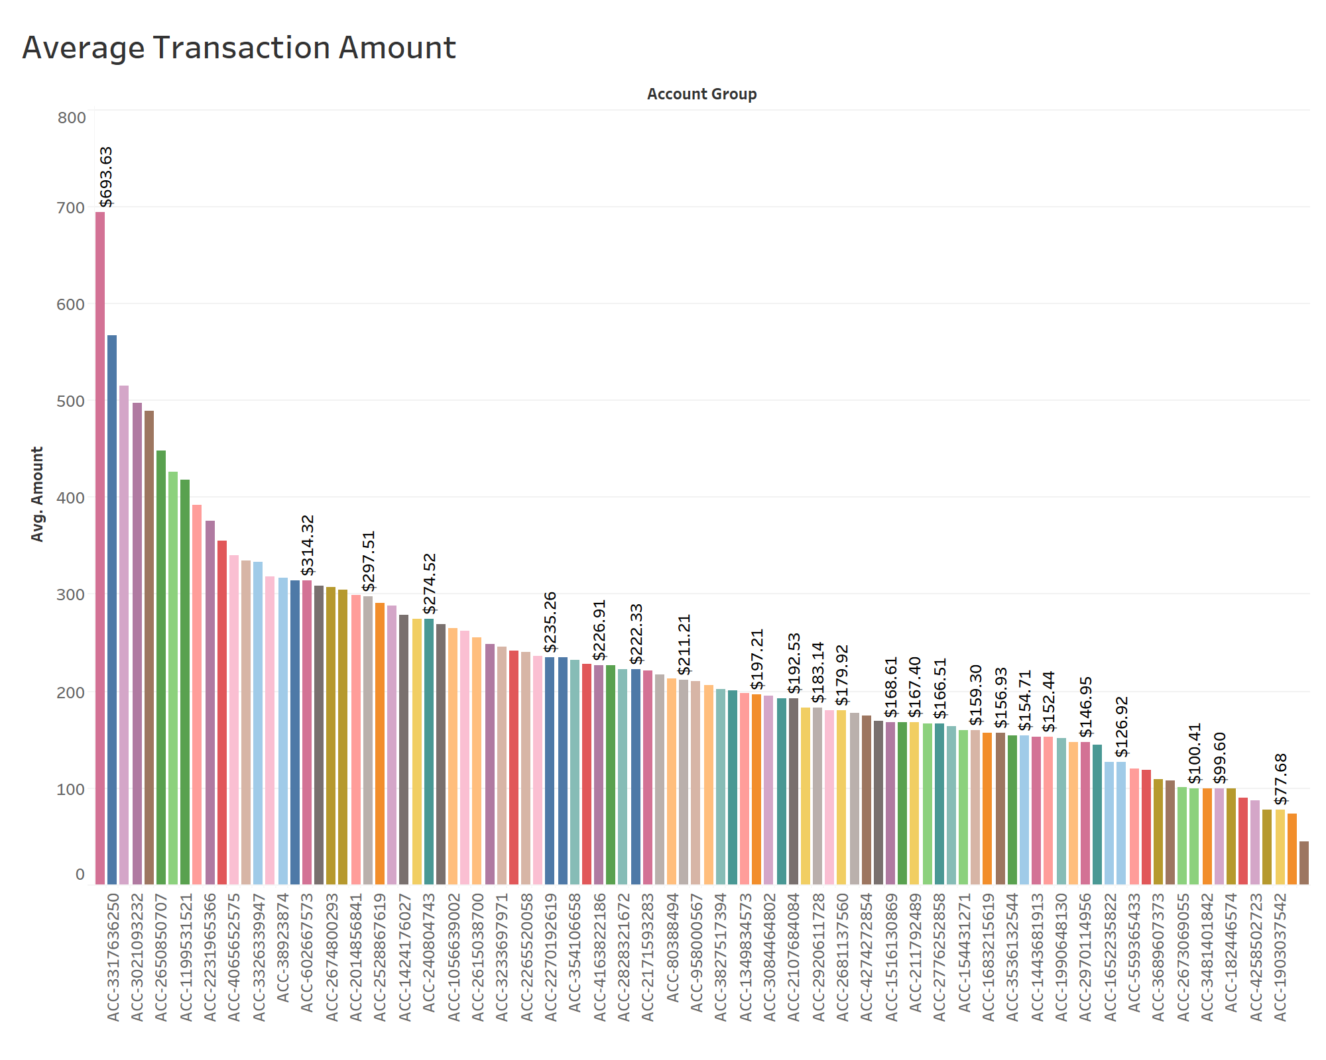
Insights Of Data
The average transaction amount for all 100 accounts within 3 months was $187.93.

Slide 4
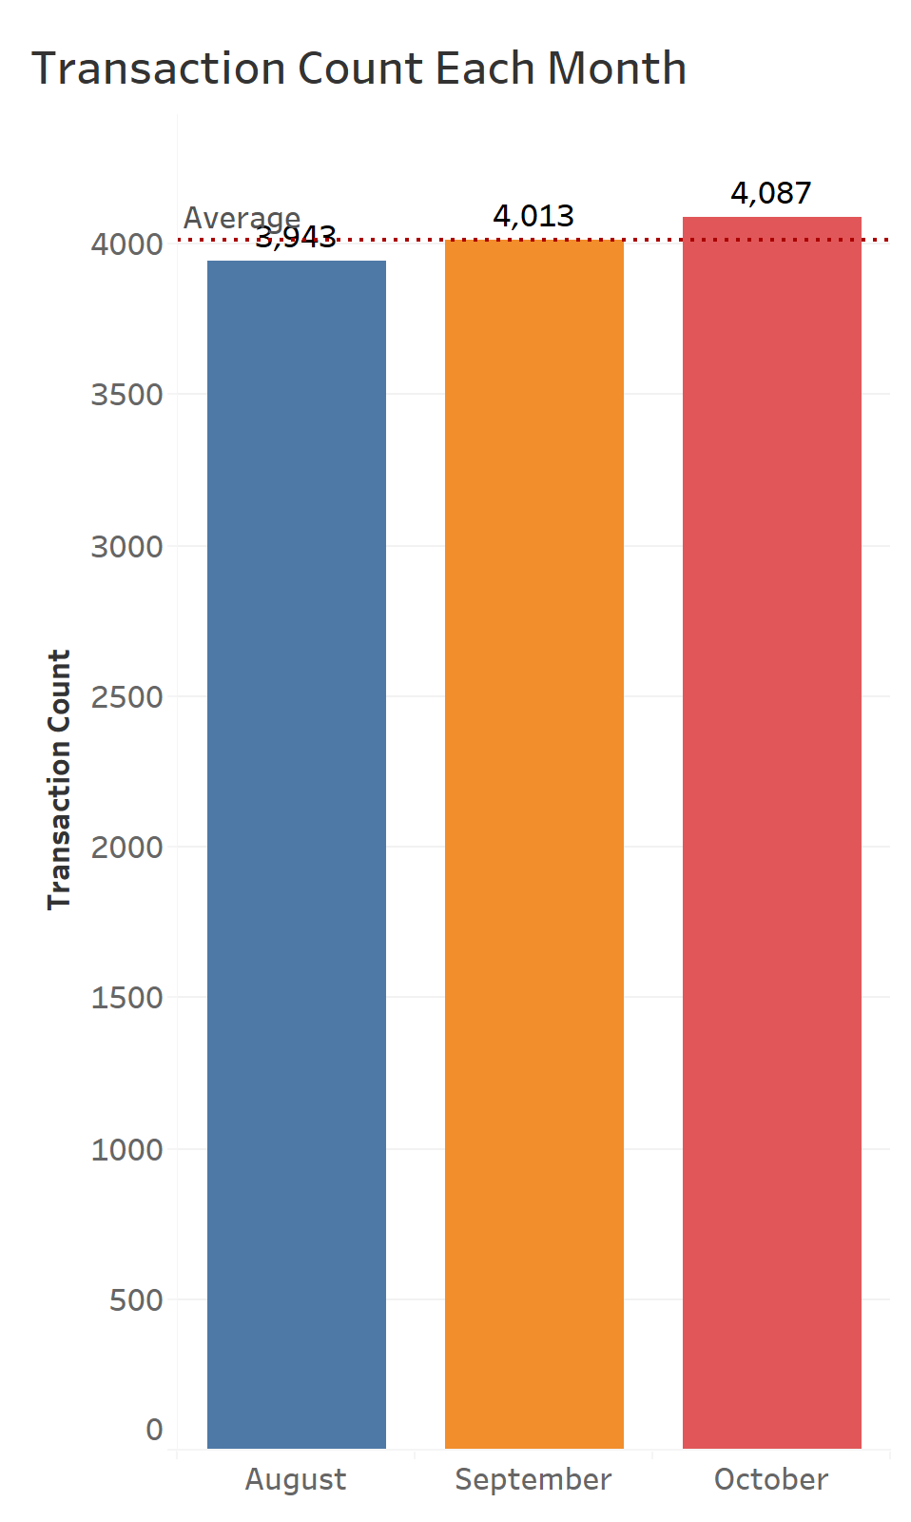
Insights Of Data
Each month, on average, 100 customers have made 4014 transactions.

Slide 5
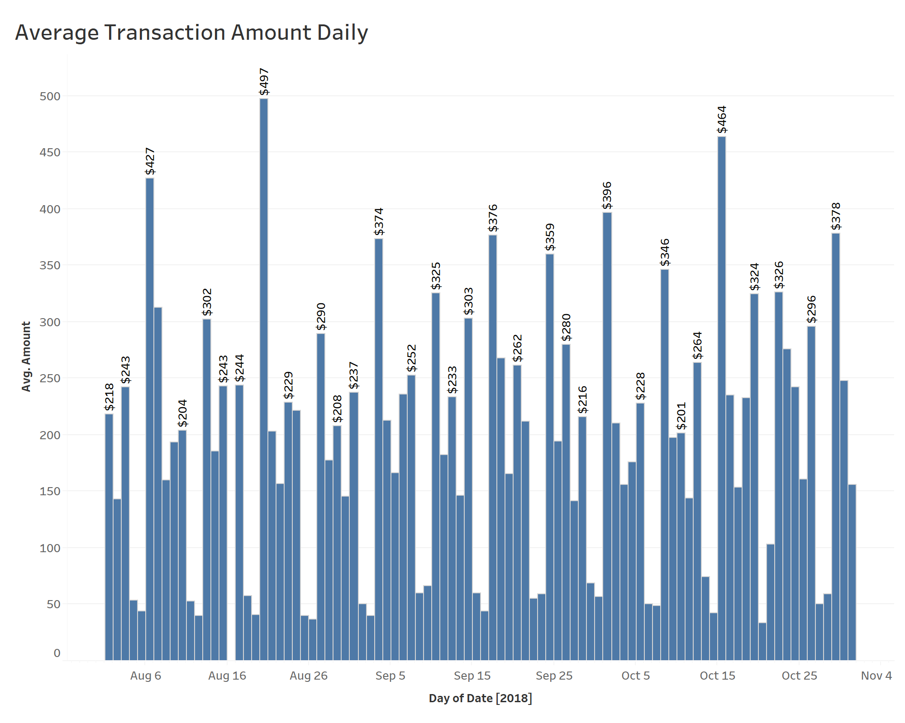
Insights Of Data
Within this 3 months period, on August 20 was the highest average transaction ($497) while the lowest was on October 20 ($34).

Slide 6
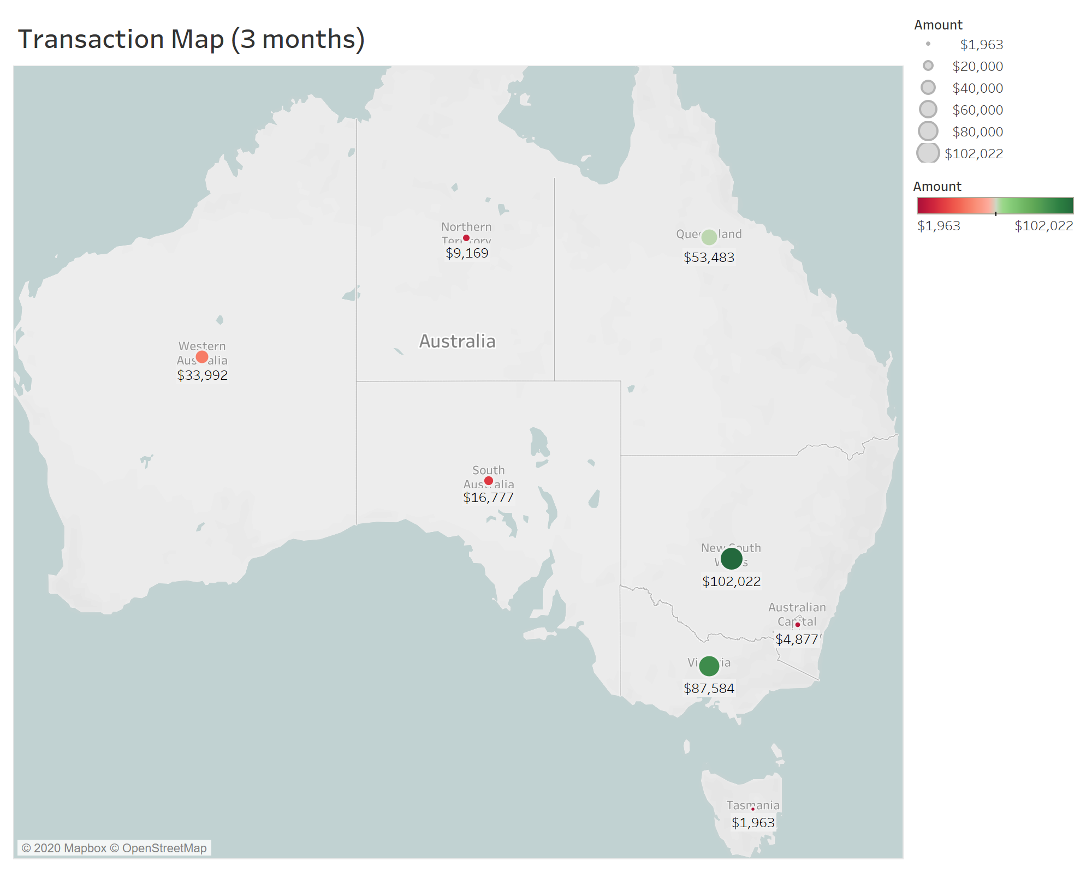
Insights Of Data
Within this 3 months period, the highest total transaction was is in NSW ($102,022), while the lowest was in TAS ($1,963).

